Slide 1
Artists Recommendation System
By: Kris Seo
Mentor: Srdjan Santic

Slide 2
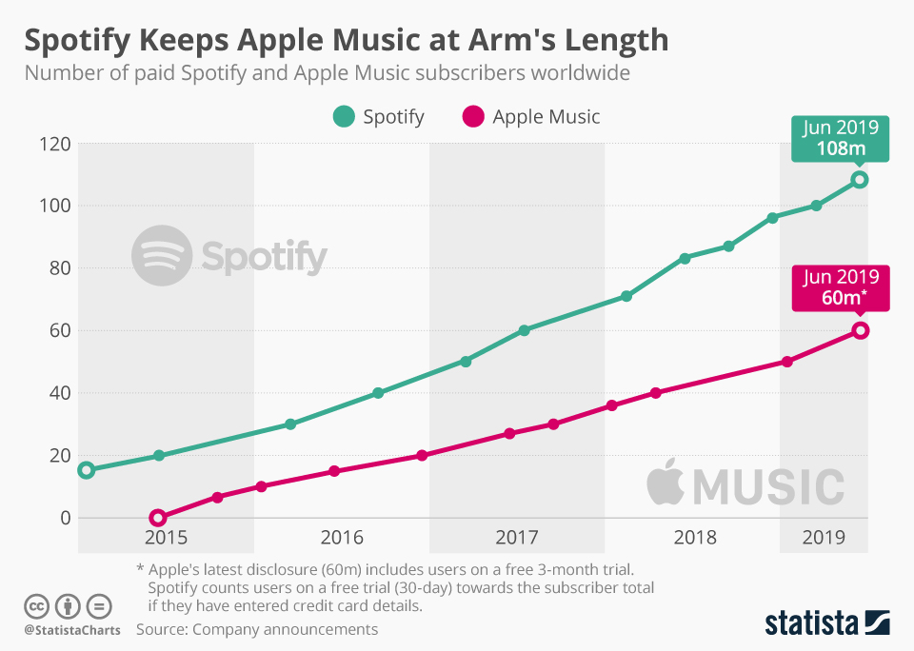
Motivation
Music streaming service becomes ubiquitous.
Technologies on music storage change people’s music consumption behavior.
Streaming wars among high technologies companies lead the companies to compete for better recommender system to keep their users.

Slide 3
Problem
Users of streaming services usually listen what they found interesting.
Artists and tracks will be limited to users without a recommender system.
The limitation of users’ preferences leads to interrupt the using of service.
More and more artists and tracks are released.
How should we recommend artists to users based on their history?

Slide 4





Clients
Who can be my clients for recommendation systems??
Any businesses or streaming services with user-item intersection data!!

Slide 5
Dataset
Acquired users data from ocelma.net which used Last FM API to collect 360,000 users and their top artists.
The Last FM data are broken in two parts, user’s activity data and user’s profile data.
User’s activity data consists of (‘user_id’, ‘artist_name’, ‘plays’).
User’s profile data consists of (‘user_id’, ‘gender’, ‘age’, ‘country’, ‘signup’).
Acquired data from Spotify Rec System and apply API to extract artists’ genres data.

Slide 6
Data Wrangling
Merged the activity data and the profile data on user’s id and filtered users in the US.
Dropped features: ‘genders’, ’age’, ’country’ and ‘sign up’.
Pivoted merged data where each row represents user and column represents artist and value represents play counts.
Filtered artists who appear in intersection of the genres and merged data.

Slide 7
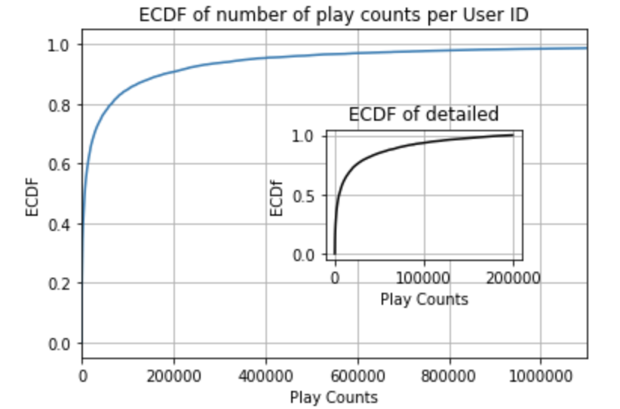
EDA
Huge difference between minimum and maximum.
ECDF plot has a long-tail data.
Need to apply threshold for further filtering.

Slide 8
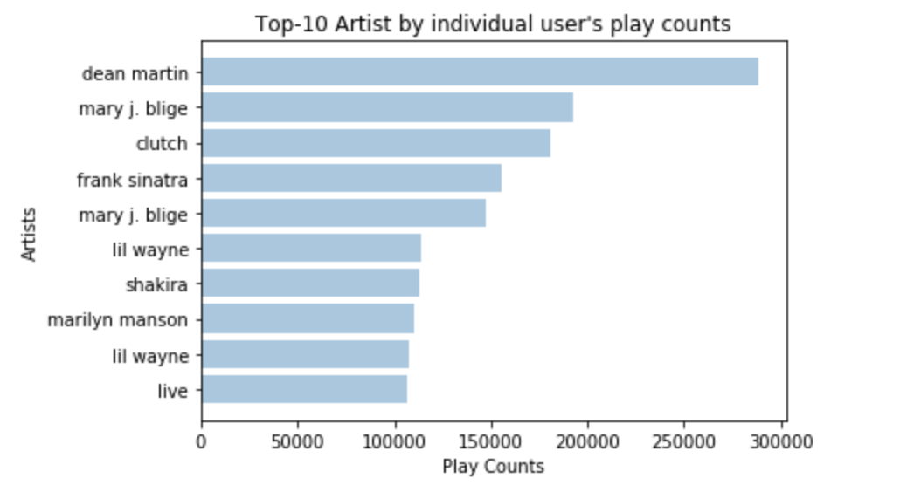
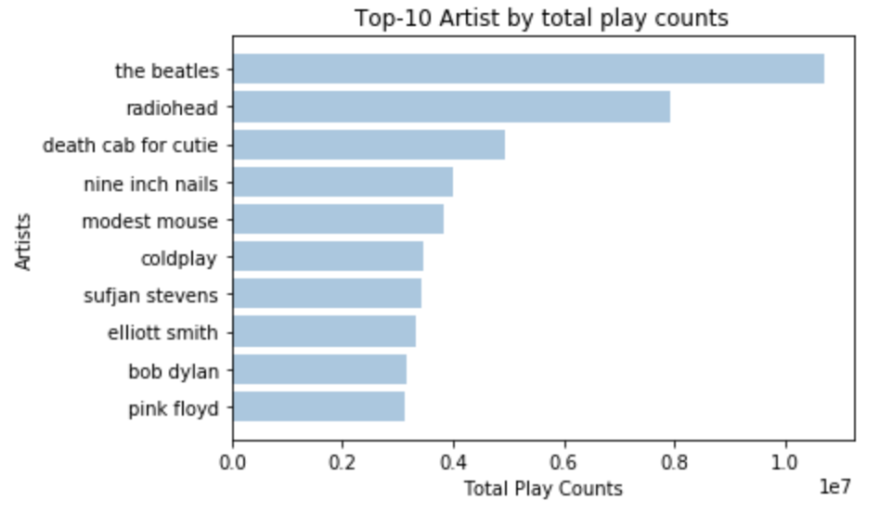
EDA (continued)
Notes:
These are the top-10 popular artists by user’s play counts and total play counts

Slide 9
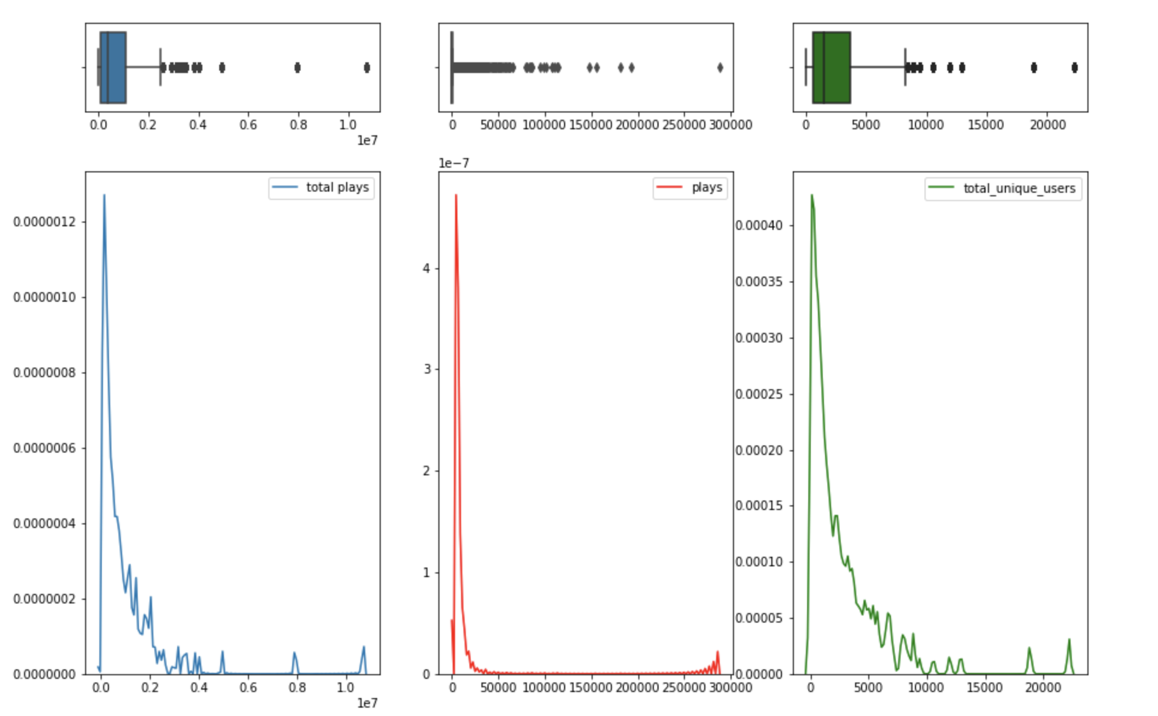
EDA (continued)
These distributions are similar to the exponential distributions and have the long tails of distribution.
Will apply threshold to prevent the noisy recommendation.
Long tails drive a significant volume of effective users for recommendation systems.

Slide 10
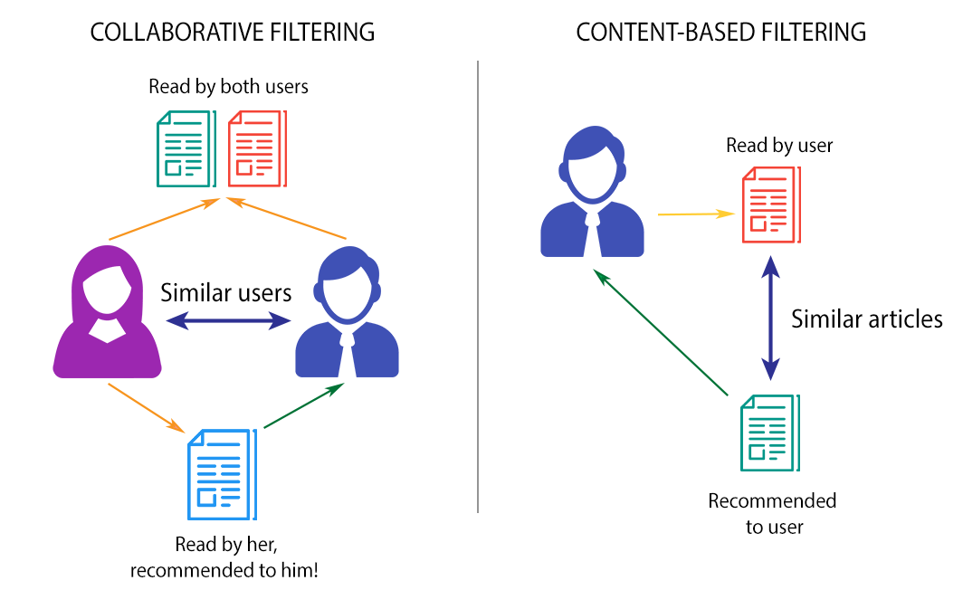
Modeling
Collaborative Filtering System
Finds the users who have a similar preference behavior of current user.
Similarity is based on user’s behavior history and other users’.
Content Based System
Finds similar items to items in user’s history.
Similarity is based on co-occurrence matrix of items.
Figure from here

Slide 11
Modeling (continued)
Hybrid Recommendation System
Combines Collaborative Filtering and Content Based System by using Matrix Factorization.
Artists
Factors
Artists
Users
Users
Factors

Slide 12
Content Based Recommendation
Calculated cosine similarity of artists’ genres, which was vectorized by Tf-IDF Vectorizer and CountVectorizer
Tf-IDF Vectorizer put less weights on frequent genres.
CountVectorizer is a simple genre frequency counter.
The similarity score indicates how each artist’s genres are similar to the other.
The similarity score value will be between 0 and 1.
Then, sort out artists based on similarity score and highest will be recommended.

Slide 13
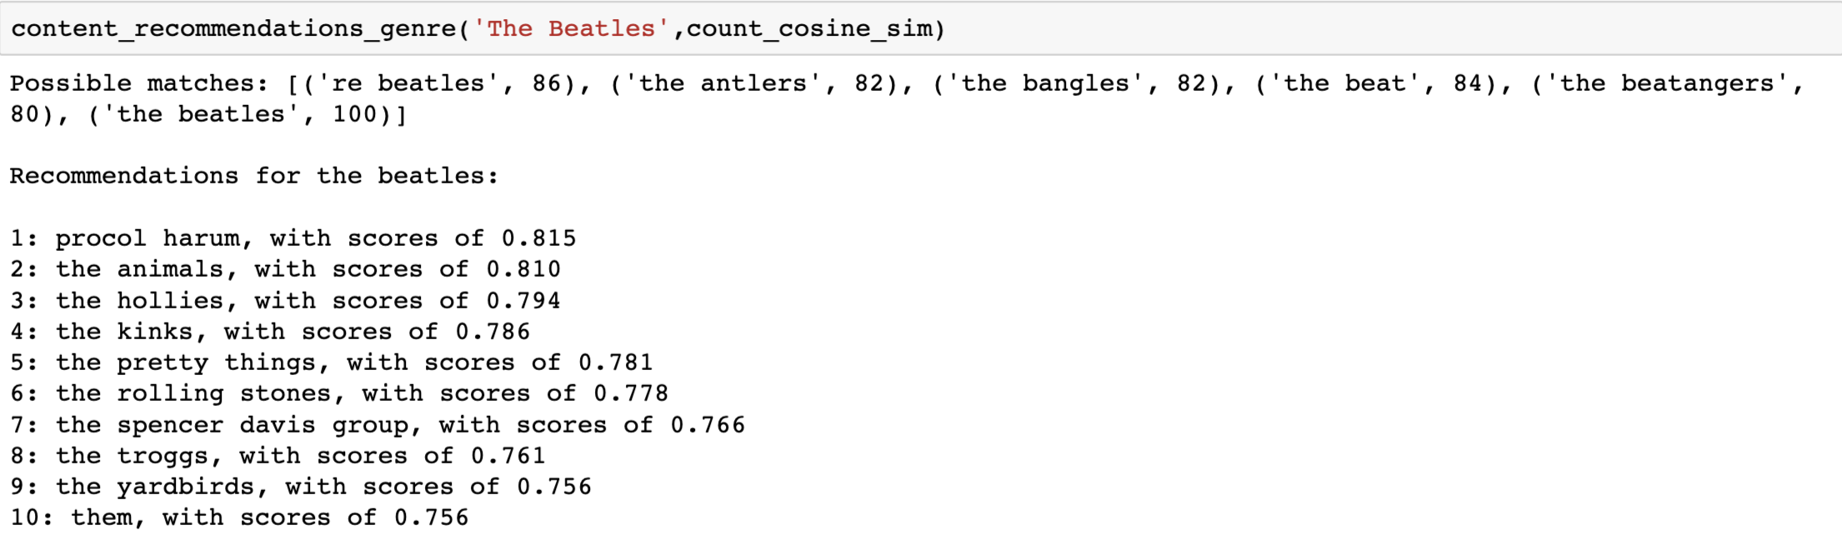
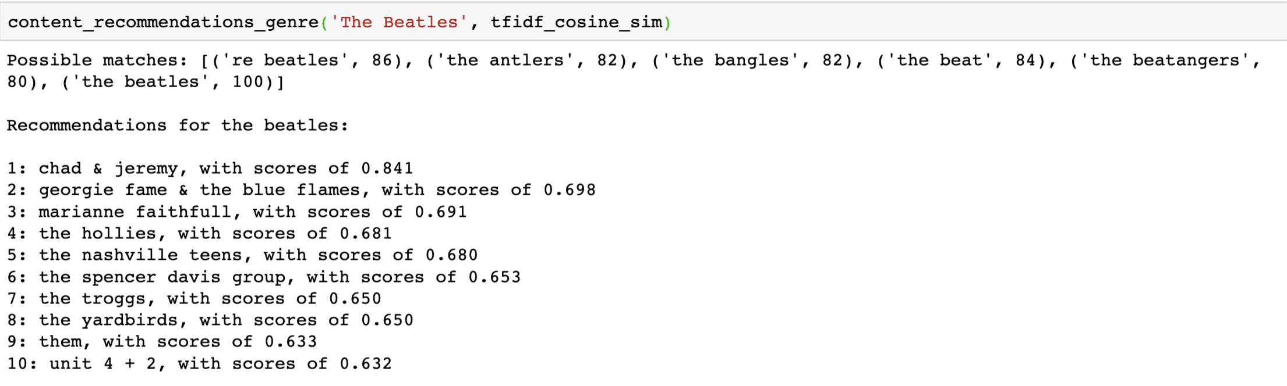
Demonstration

Slide 14
Collaborative Filtering Recommendation with K-Nearest Neighborhood
With the pivoted data where each row represents an artist and column represents a user with value representing actual play counts, K-Nearest Neighborhood can be applied to find distance of K similar artists.
However, outliers can influence the distance metrics hugely.
How to get over this problem?
By using binarized data, where 1 indicates a user played and 0 indicates a user did not play, we don’t have to concern about outliers anymore.
Closest distance will be the most similar artists.

Slide 15
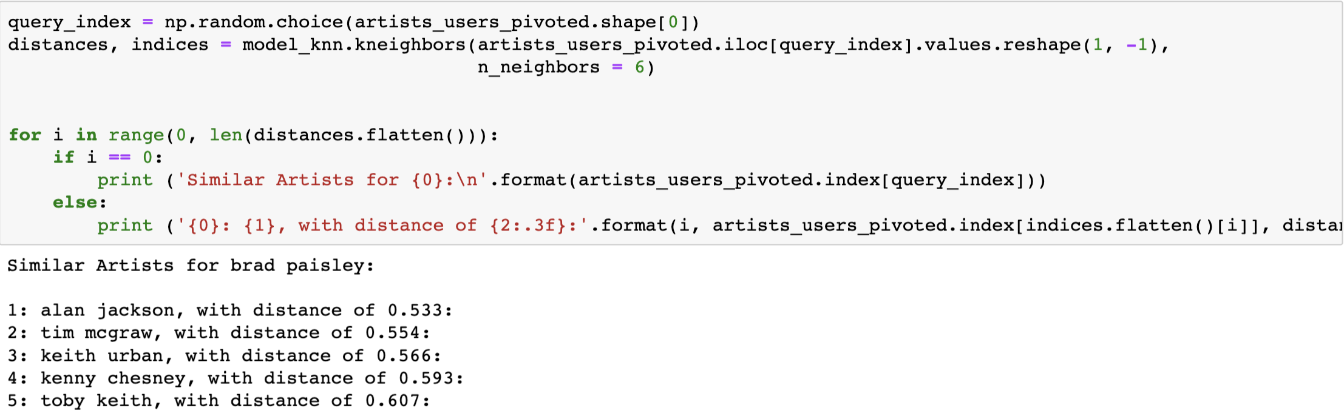
Demonstration

Slide 16
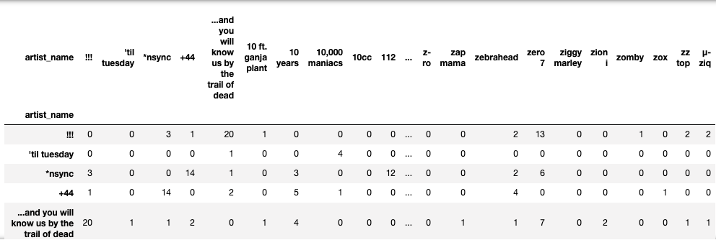
Co-occurrence matrix
Elements of co-occurrence matrix represent the number of times its column’s artist appeared together with the artists contained by its row’s user.
For example, ‘+44’ appeared 1 time with ‘!!!’ contained by first user’s preference vector and ‘zero 7’ appeared 13 times with ‘!!!’.
Notes:
Item based collaborative filtering

Slide 17
Co-occurrence Matrix (continued)
By using a dot product of the co-occurrence matrix and the user’s preference vector, we can get recommended artists based on how frequently the artists appeared together with the user’s artists.

Slide 18
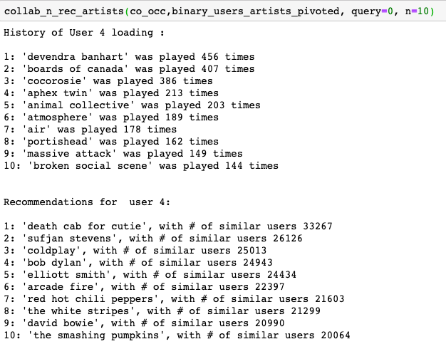
Demonstration

Slide 19
Train-Test-Split
Users
Typical train- test split method won’t work for Matrix Factorization Models
Set original users and artists intersection as a test set
Hide test size of the the intersection chosen at random by setting 0 and set as a train set.
Test Set
Artists
Train Set

Slide 20
Light FM Train-Test-Split
Users
Test Set
Light FM train and test set do not have common intersections of users and artists,
Artists
Users
Users
Train Set
Artists
Artists

Slide 21
Light FM Recommendation
Light FM model estimates hidden representations in a high-dimensional space, for users and items in a way that encodes user preferences over items.
Multiply estimated latent vectors for users and item metadata to rank recommended items
Use Matrix Factorization Method because our data is sparse, containing lots of zeros !!
Check the video for more information. LightFM Hybrid Recommendation
We will use AUC score for evaluating model.
AUC score measures the quality of the overall ranking

Slide 22
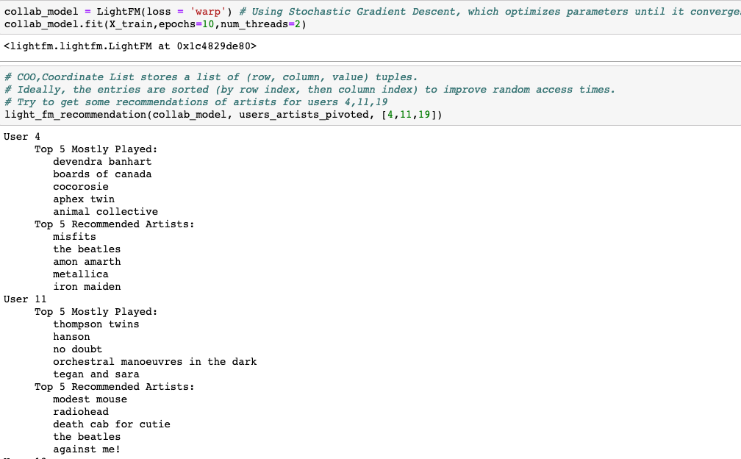
Light FM Collaborative Filtering

Slide 23
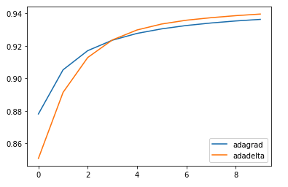
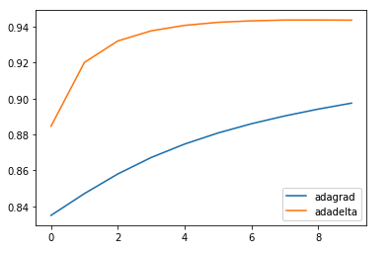
Tuning Hyperparameters for Light FM
To improve the model, we need to tune hyperparameters for Light FM
Adadelta - Adaptive Learning Method
Adagrad -Adaptive Subgrad. Method
Epoch = 10
Epoch = 30
Notes:
Pre-parameters for learning rates. Adadelta (adaptive learning method) works well with high dimensions. Adgrad (adaptive subgradient method)

Slide 24
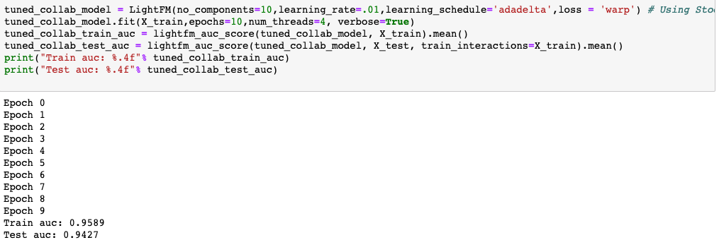
Evaluation for Tuned Model
Notes:
AUCmeasures the quality of the overall ranking

Slide 25
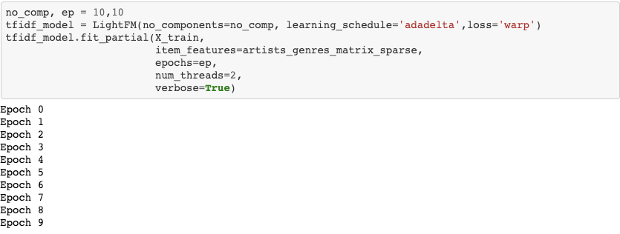
Light FM Hybrid Recommendation
Add artists and genres sparse matrix to the model as item features.

Slide 26
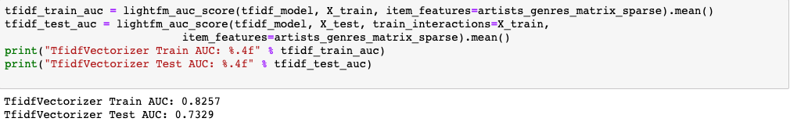
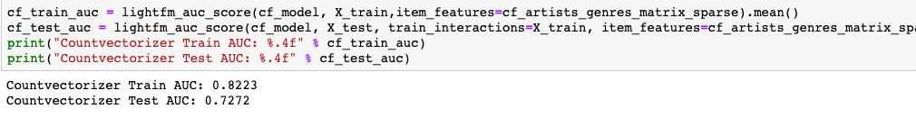
Evaluation
Both of them are doing better than random!

Slide 27
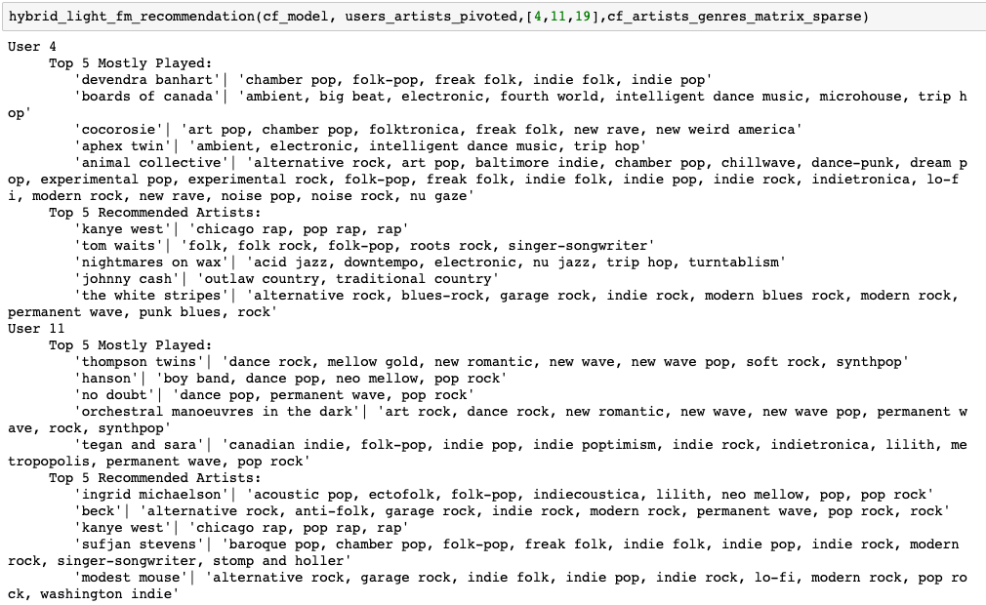
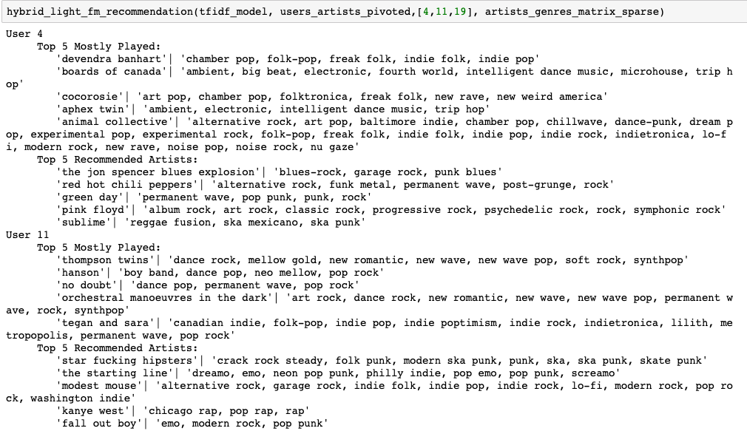
Demonstration

Slide 28
Implicit Alternating Least Square
This method will randomly initialize U feature matrix and solve for V; then, the solution matrix V will solve for U. Keep iterating back and forth these procedures until U and V converge that approximate the original matrix as best as I can.
U (m users and k hidden factors) and V (k hidden factors and n items)

Slide 29
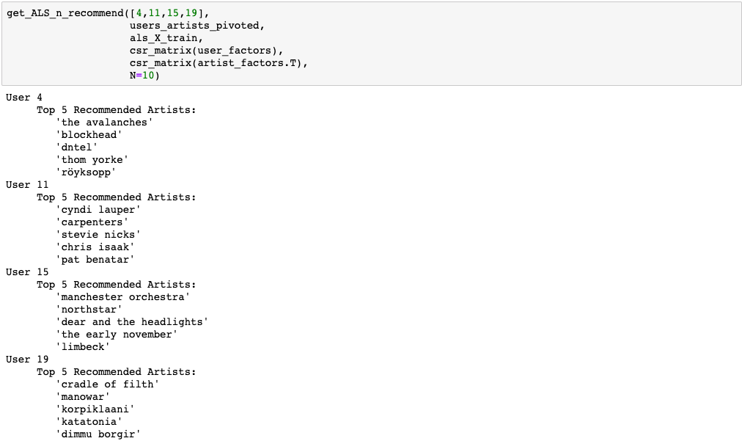
Evaluation/Demonstration

Slide 30
Future Work
Implementing track recommendation via artist recommendation
Building Recommendation with Convolutional Neural Network
A/B Test for each recommender systems via online users to evaluate the systems.

